Slide 1
MULTIGRID POISSON SOLVER
蔡欣蓉 許景皓
Computational Astrophysics
2020/6/30

Slide 2
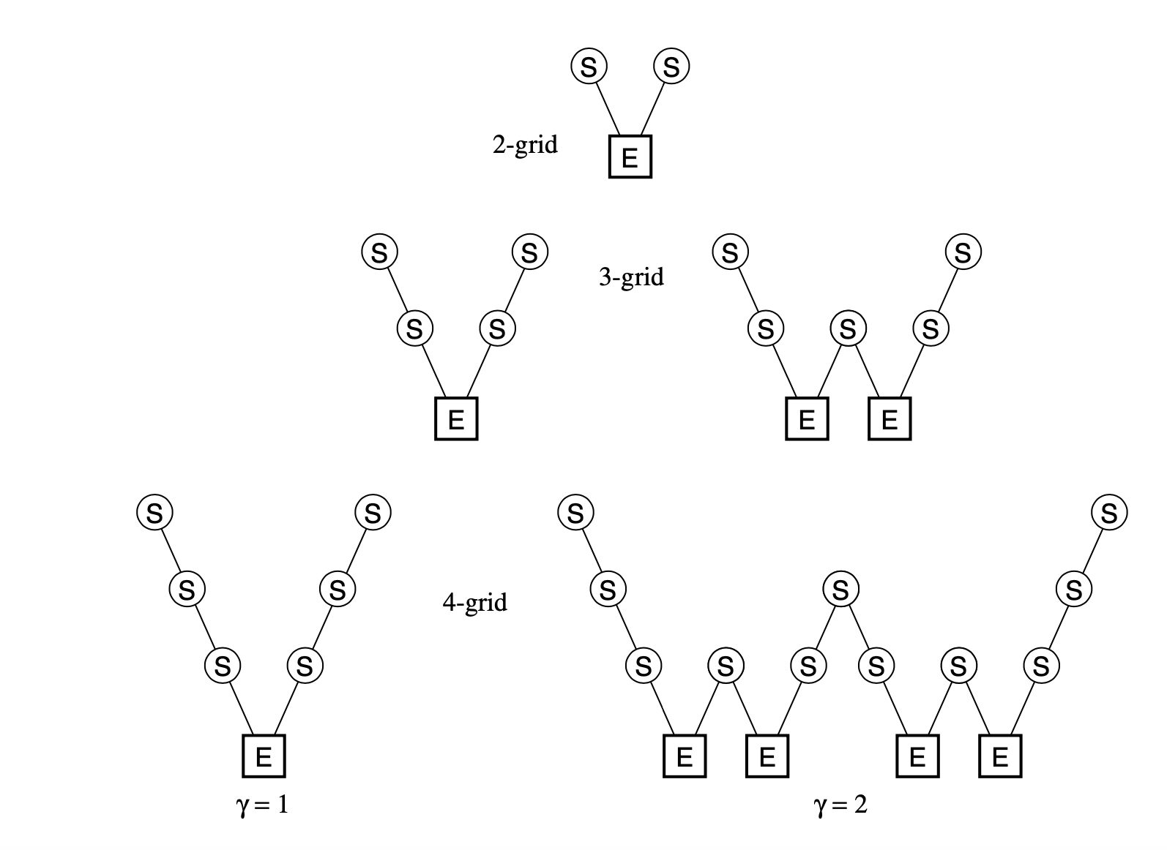
Outline
Introduction to multigrid
CPU implementation
GPU implementation
Experiments!

Slide 3
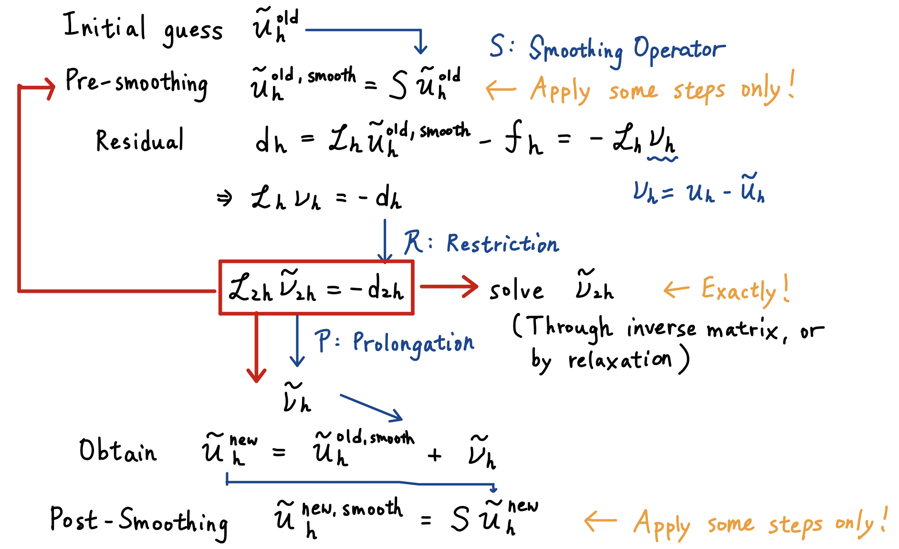
Multigrid Method Review
Notes:
Difference U-anaU 猜 0是因為預期它很小

Slide 4
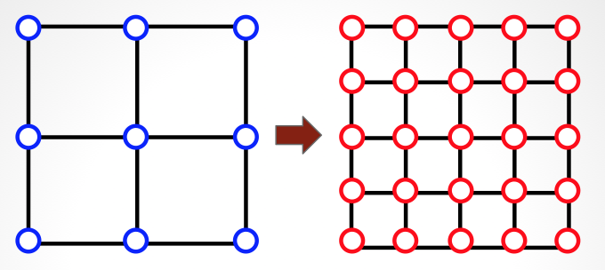
CPU implementation(OpenMP)
Exact solver & smoothing
odd-even ordering is important!
Prolongation & Restriction:
basically interpolation & extrapolation
Exact solver:
Inverse Matrix
Gauss Seidel Even/Odd
Data structure: linked list
each dot is independent
Notes:
Inverse Matrix 會收斂到跟GS一樣，但是不會比GS快，而且也不好平行。
再加上他考慮的點只有neighboring(跟GS不同，neighbor擴散)，所以不會比較好。

Slide 5
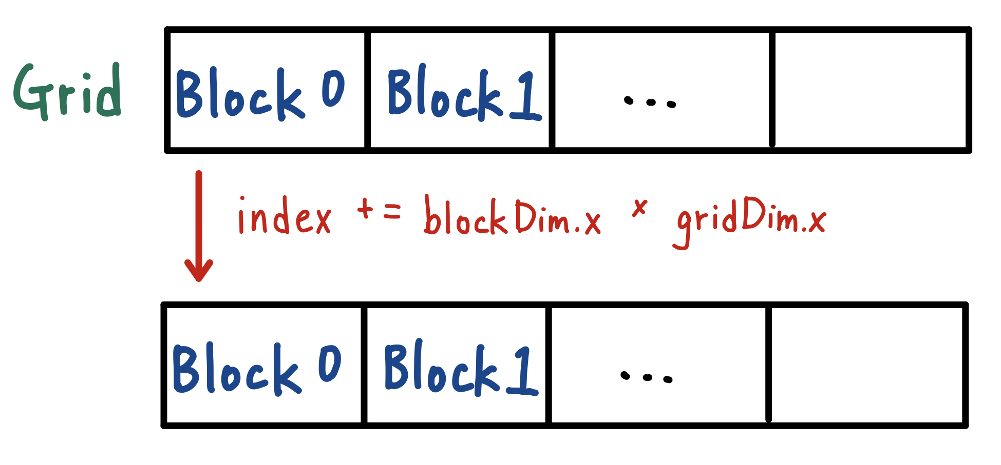
GPU Implementation
Basic Idea
Add up the error$→$Parallel Reduction
Decrease the memory reading time$→$Texture Memory

Slide 6
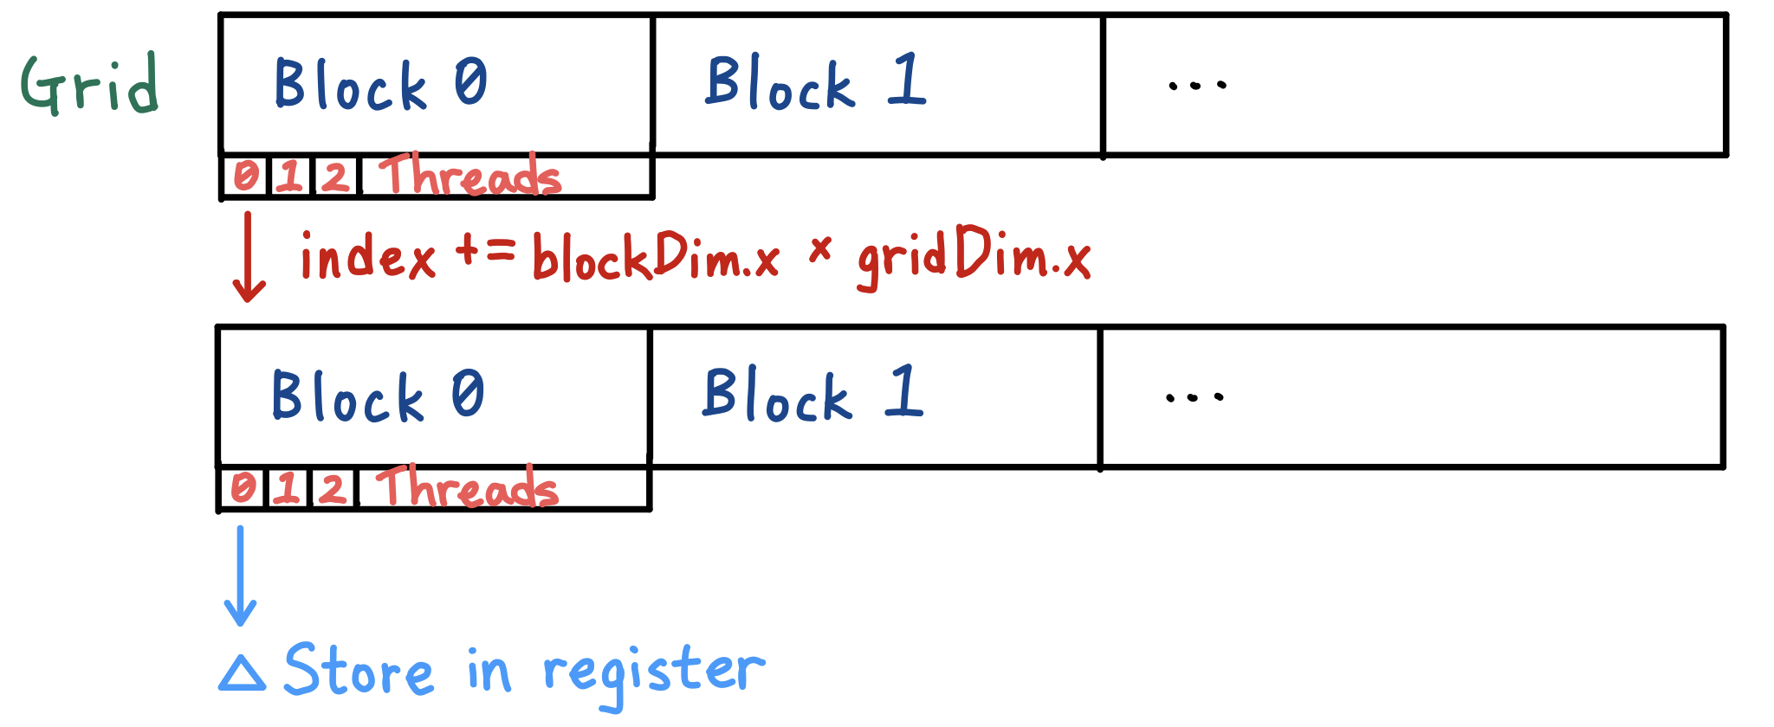
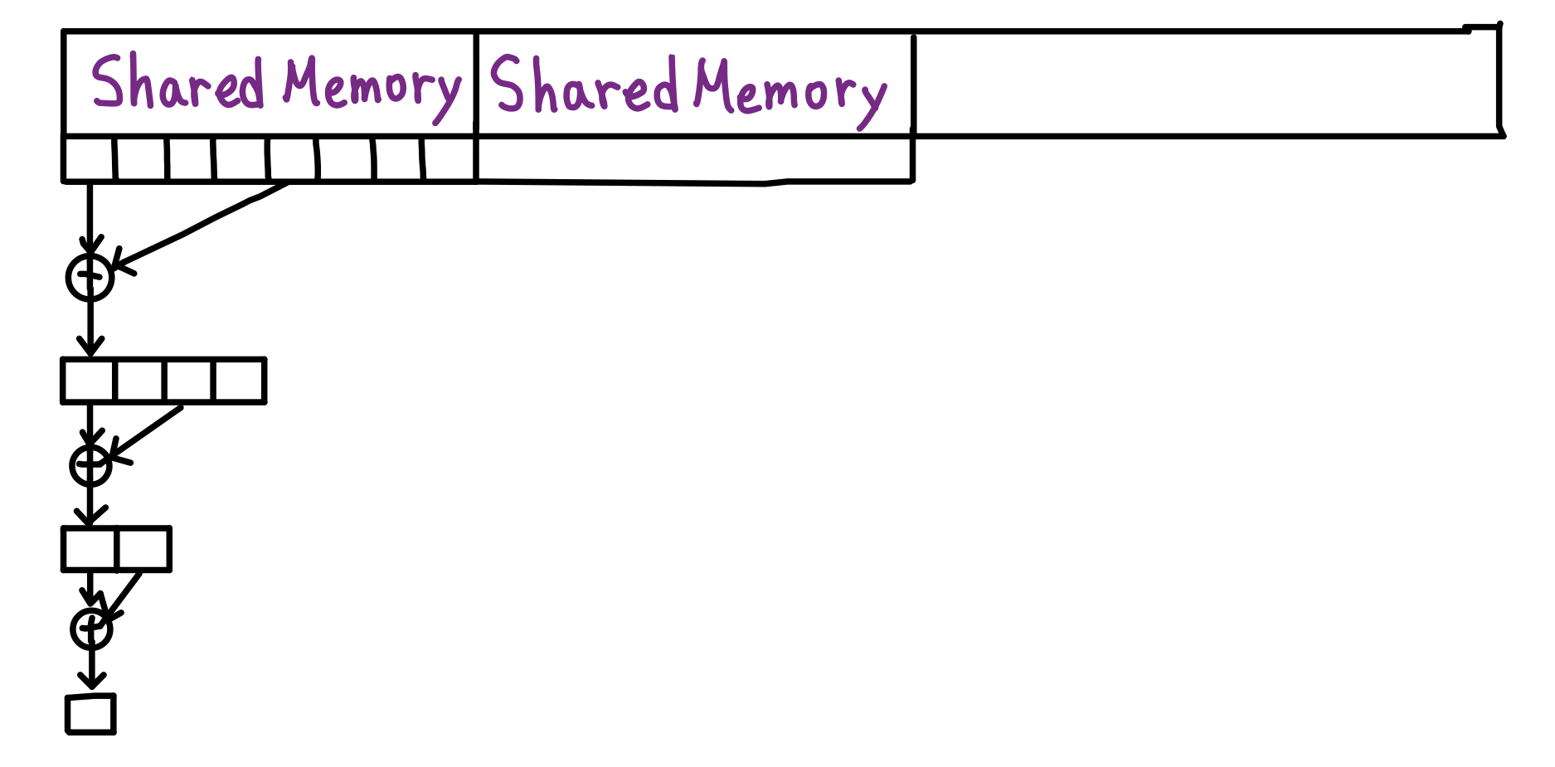
Parallel Reduction

Slide 7
Maximizing GPU Power
Block size and grid size affects.
 |  | Block Size
 |  | 2 | 4 | 8 | 16 | 32 | 64 | 128 | 256 | 512 | 1024
Grid Size | 10 | 0.13 | 0.24 | 0.37 | 0.78 | 1.21 | 1.45 | 1.75 | 1.94 | 1.68 | 2.46
 | 100 | 0.70 | 0.94 | 1.27 | 1.87 | 2.26 | 1.52 | 2.33 | 1.21 | 2.11 | 3.79
 | 1000 | 0.78 | 1.09 | 1.23 | 1.91 | 1.55 | 2.05 | 2.32 | 2.32 | 1.74 | 2.00
 | 10000 | 0.96 | 1.69 | 1.67 | 1.87 | 2.78 | 1.76 | 1.22 | 1.40 | 2.47 | 1.62
 | 100000 | 0.89 | 1.53 | 1.73 | 1.38 | 3.26 | 2.01 | 2.67 | 2.12 | 2.52 | 1.74
Speed Up Rate of Different Block Size and Grid Size
with N = 1024 getSource_GPU function
So the more detail discussion will use CPU.

Slide 8
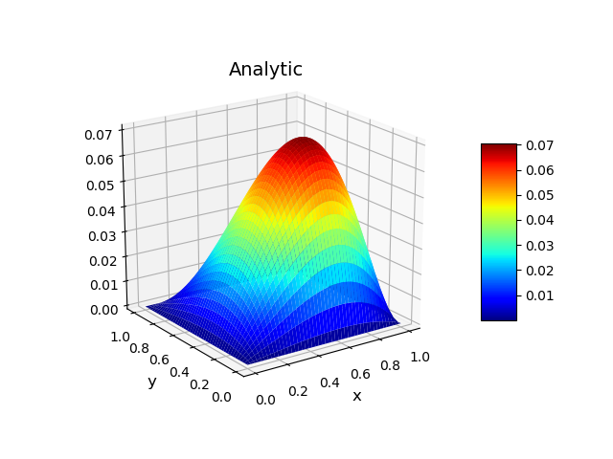
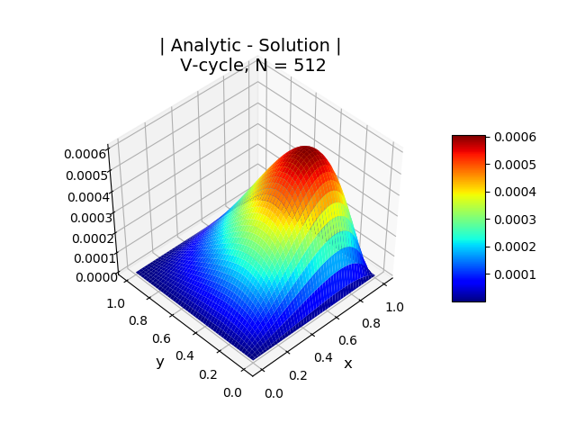

Test Problem 1
$∇^{2}u\left(x,y\right)=2x(y−1)(y−2x+xy+2)e^{x−y}$, $(x,y)∈(0,1)×(0,1)$
With boundary conditions,
$$u\left(x,0\right)=u\left(x,1\right)=0, x∈[0,1]$$
$$u\left(0,y\right)=u\left(1,y\right)=0, y∈[0,1]$$
Has solution
$$u\left(x,y\right)=e^{x−y}∙x∙(1−x)∙y∙(1−y)$$

Slide 9
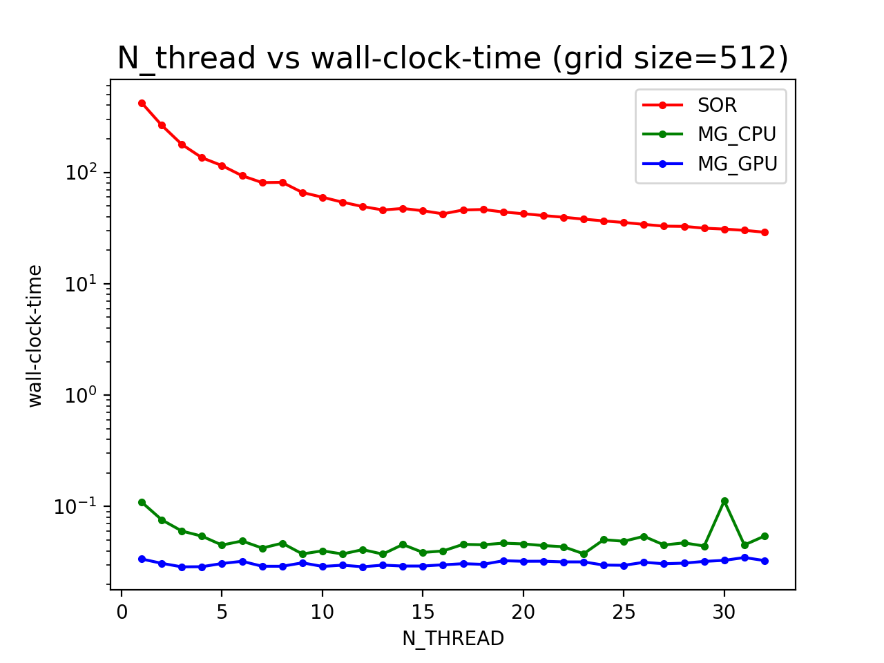
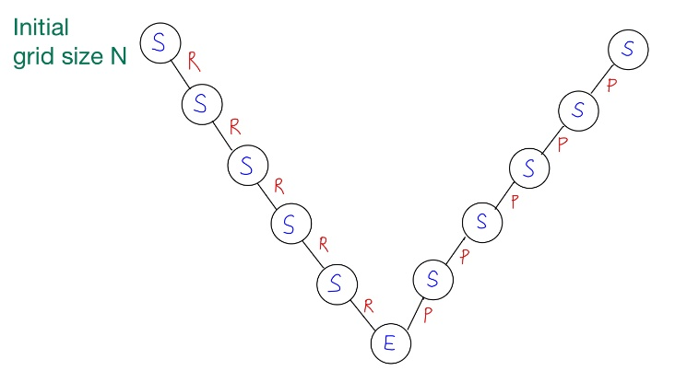
Compare SOR, MG_CPU, MG_GPU Different OpenMP Threads
SOR, MG_CPU decrease with Nthread.
MG_GPU stays nearly the same.
V-cycle

Slide 10
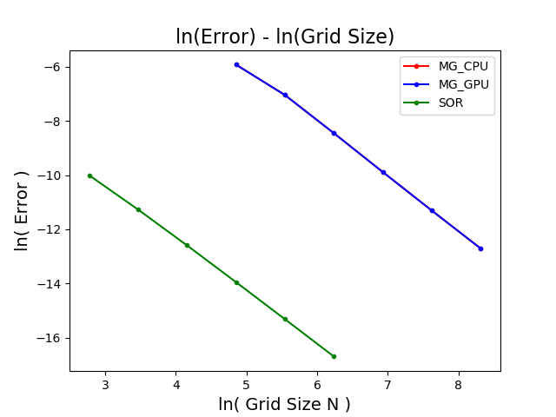
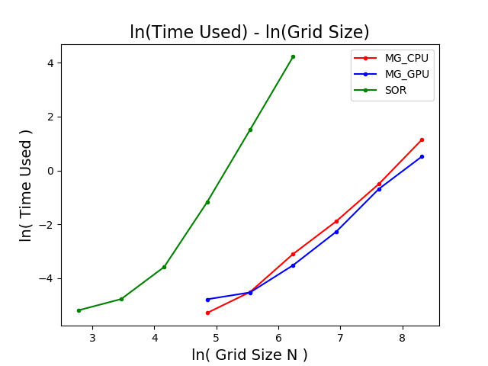
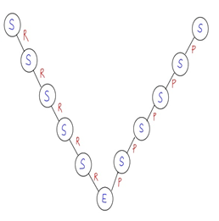
Compare SOR, MG_CPU, MG_GPU
Error 2nd order accurate
Using memory to exchange time used.
Notes:
MG_CPU 和 MG_GPU 重合，save to use MG_CPU only for the result.
MG_GPU time used is slightly below MG_CPU.

Slide 11
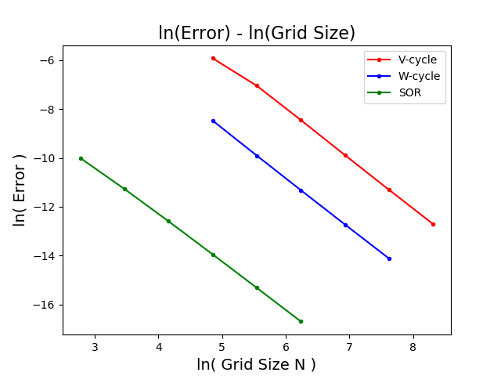
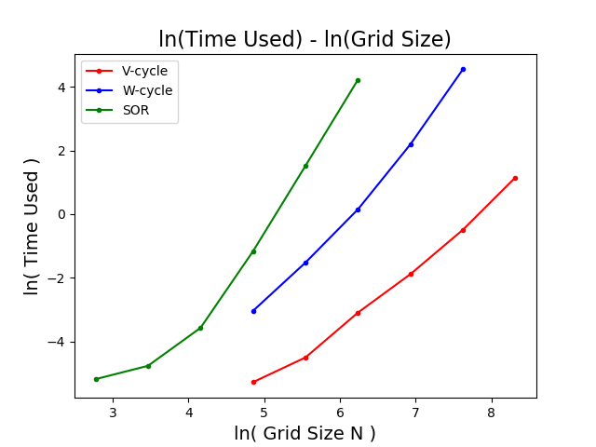
Different Structure of the Cycle
Notes:
Why we inspect more details on V-cycle,
Cause W is just many V.

Slide 12
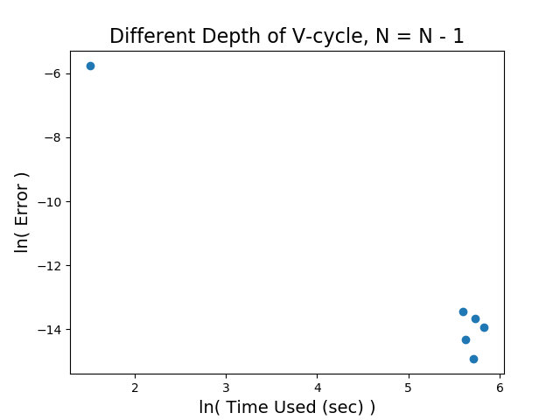
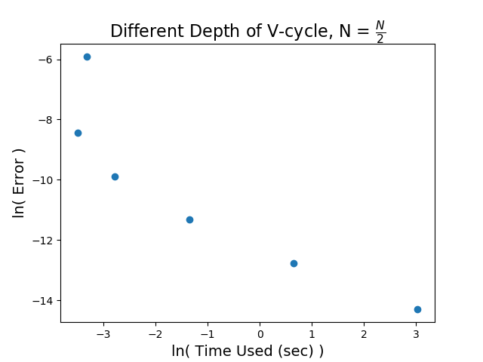
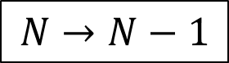
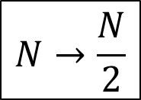
V-cycle Different Depth and Different Relation of N
Deepest Level
$$N→\frac{N}{2}$$
Deepest Level
$$N→N−1$$
Level-5
Level-4
Level-3
Level-2
Level-1~5
Level-1
Even though N=N-1 is better at interpret the grid before the restriction, but we are dealing with the over all convergence.
Again, there is some kind of trade off between memory and time.
Notes:
提最深的最不準，但是最快，需要的memory也最大。
Test Case : V 只跑一次
重點擺在N->N-1

Slide 13
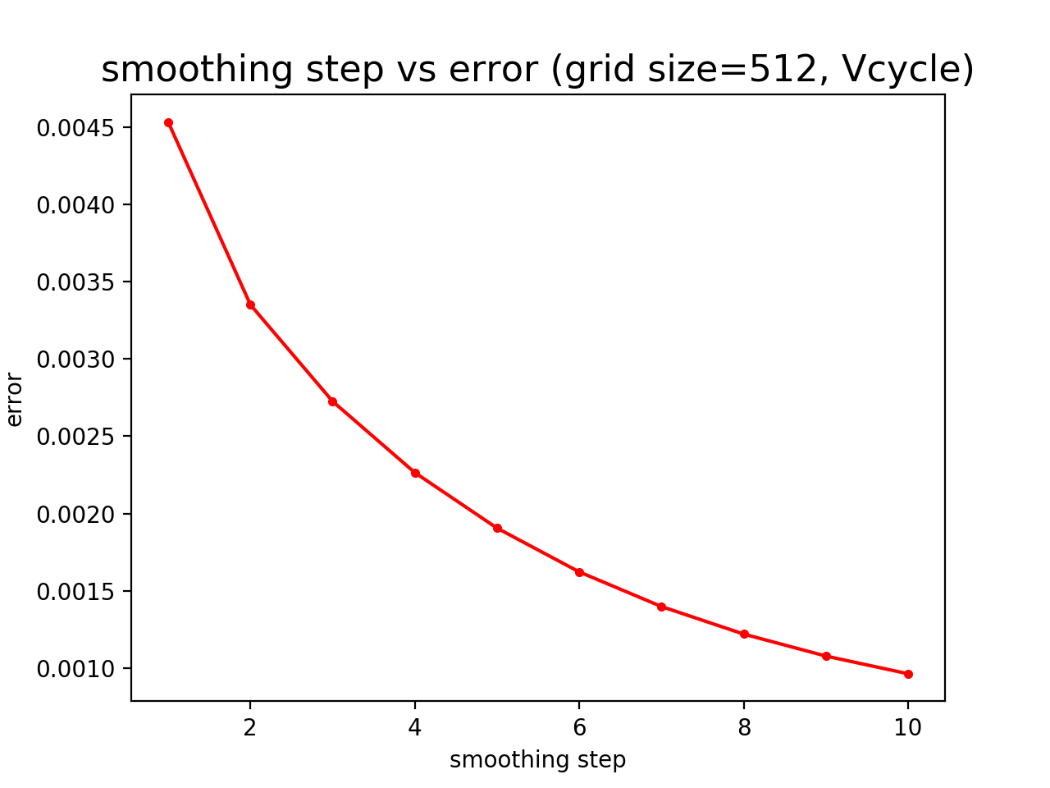
Error decays with increasing smoothing steps
Notes:
所以我們想看每個smoothing step 都不同的情況。

Slide 14
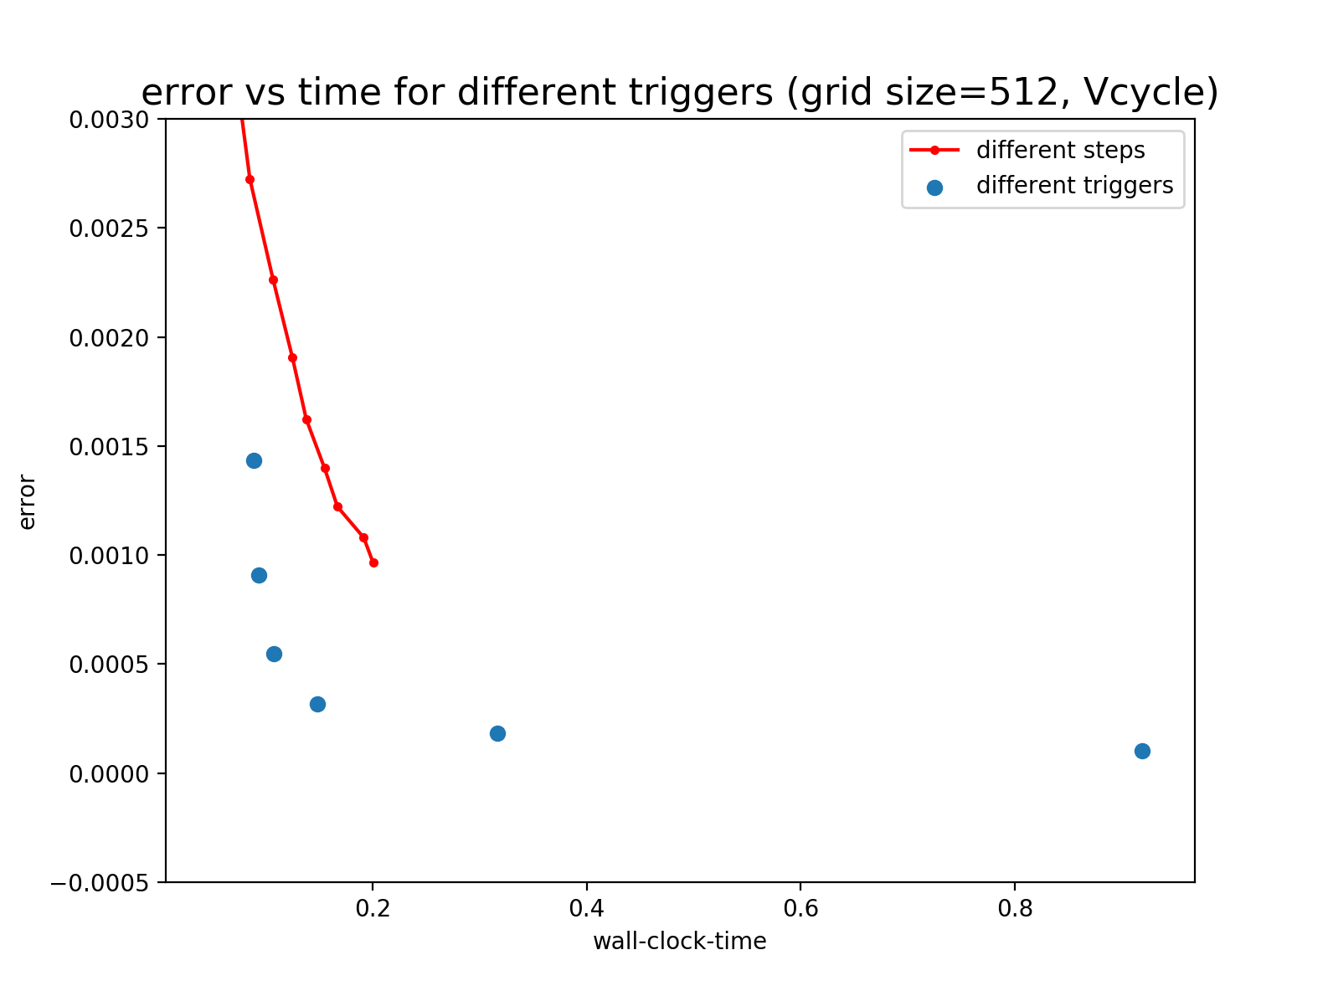
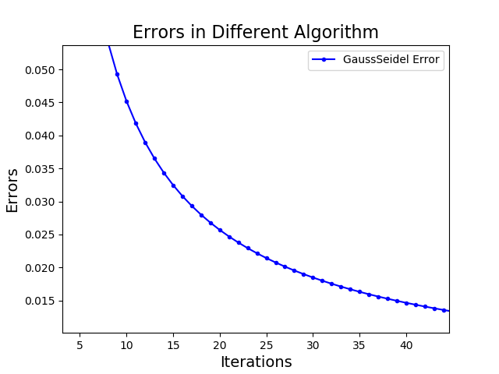






How about using trigger to decide smoothing step?
Error Slope
$${trigger=0.01∗0.5}^{0}$$
$${0.01∗0.5}^{1}$$
$${0.01∗0.5}^{2}$$
$${0.01∗0.5}^{3}$$
$${0.01∗0.5}^{4}$$
$${0.01∗0.5}^{5}$$
Notes:
Trigger better

Slide 15
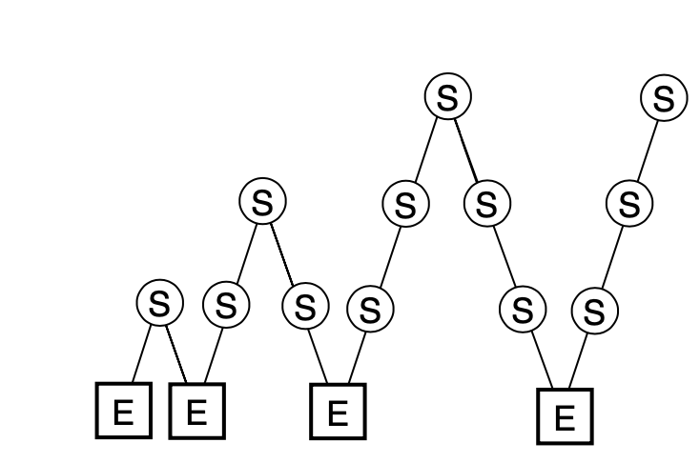
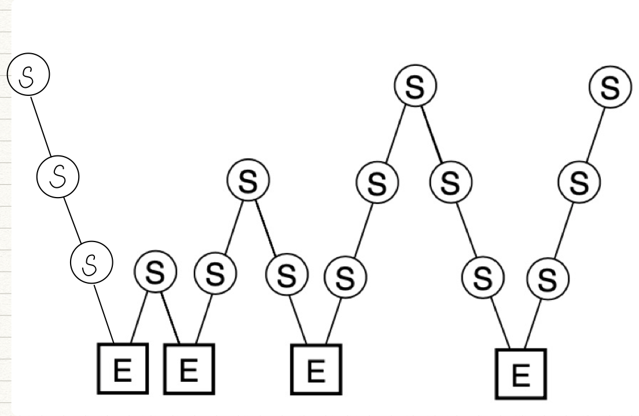
Full Multigrid
Compare with MG F cycle
Notes:
Exact solver解的東西不一樣 FMG 是解真正的source
MG是解residual

Slide 16
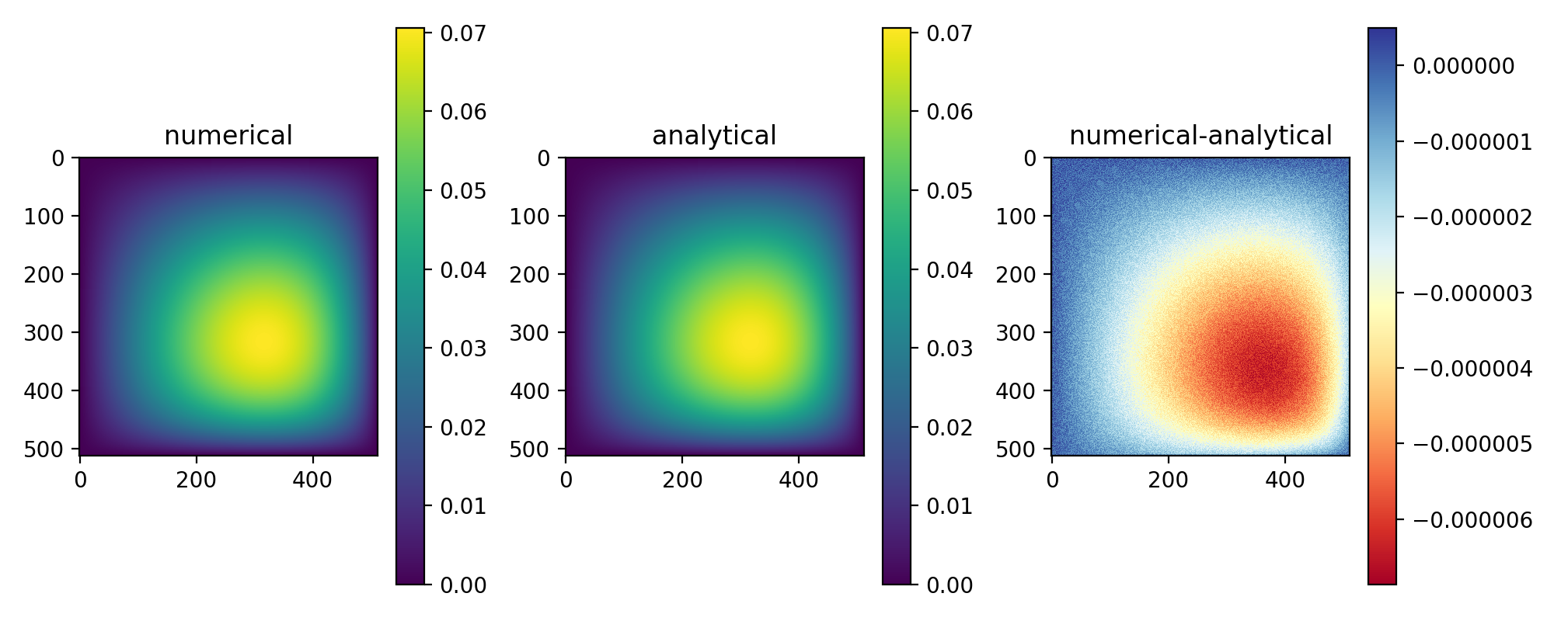
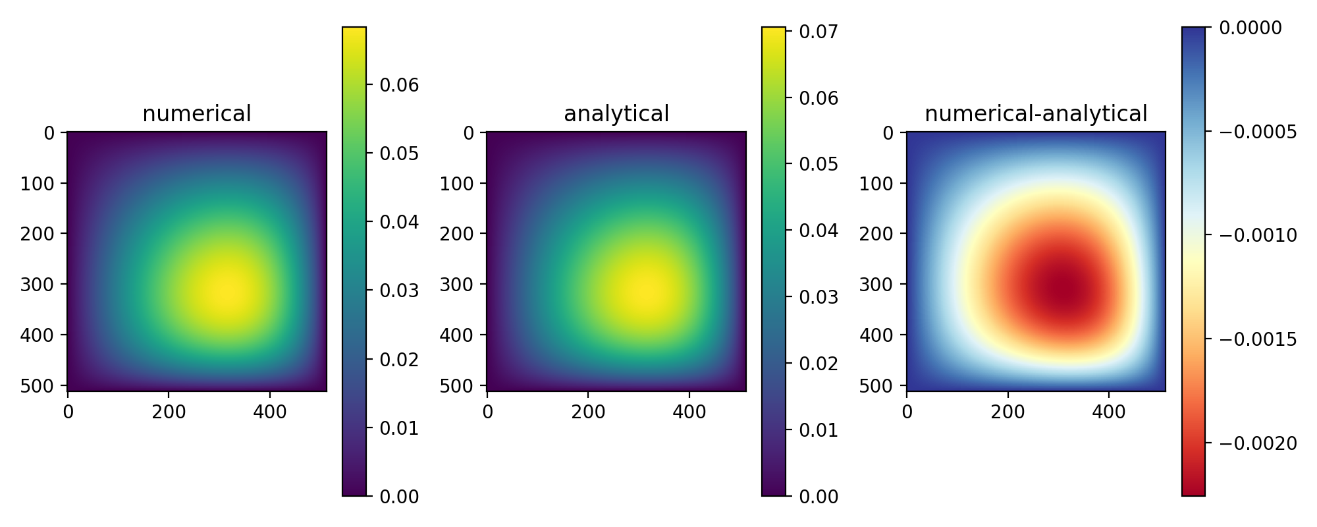
Full Multigrid(FMG) -Test Problem1
FMG
Error= 2.55e-06
F
Error=8.91e-04

Slide 17
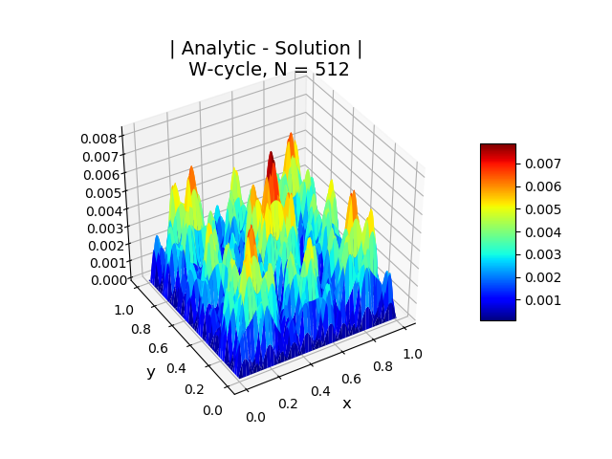
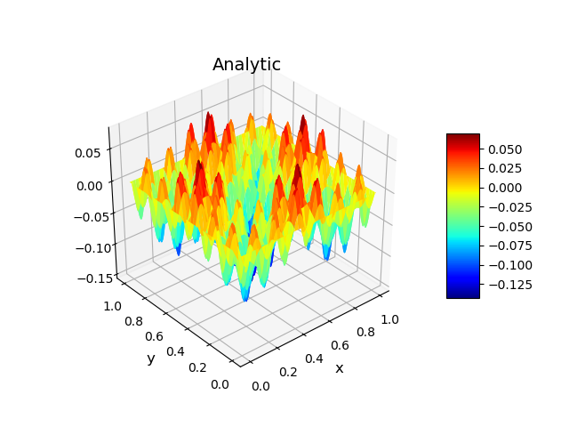
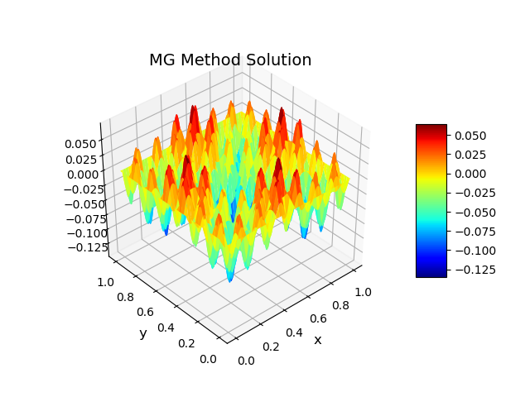
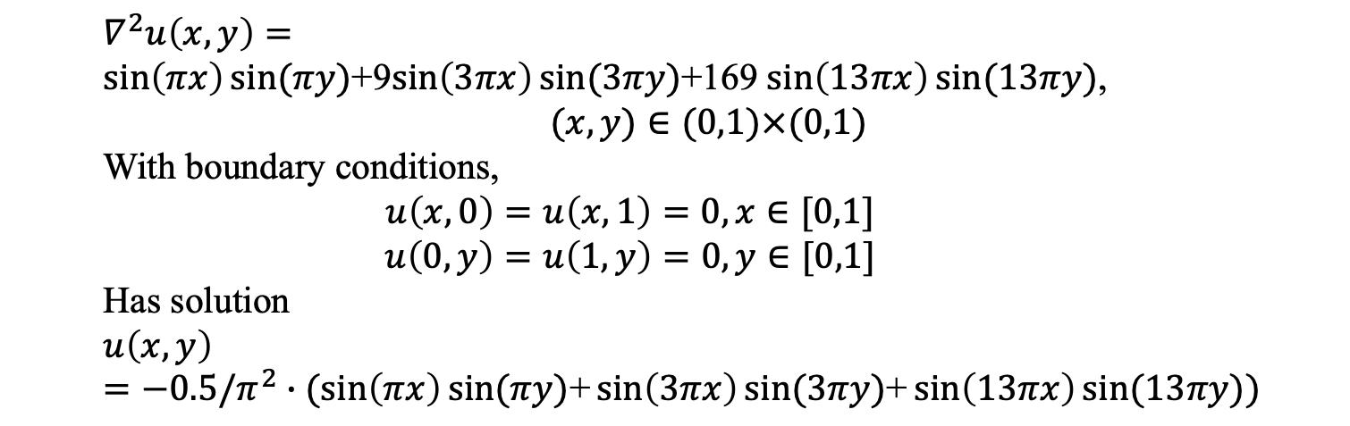
Test Problem2
$$∇^{2}u\left(x,y\right)=$$
$\sin\left(πx\right)sin⁡(πy)$+9$\sin\left(3πx\right)sin⁡(3πy)$+169 $\sin\left(13πx\right)sin⁡(13πy)$,
$(x,y)∈(0,1)×(0,1)$
With boundary conditions,
$$u\left(x,0\right)=u\left(x,1\right)=0, x∈[0,1]$$
$$u\left(0,y\right)=u\left(1,y\right)=0, y∈[0,1]$$
Has solution
$$u\left(x,y\right)=−0.5/π^{2}∙(sin\left(πx\right)sin⁡(πy)\text{+}\sin\left(3πx\right)sin⁡(3πy)\text{+}\sin\left(13πx\right)sin⁡(13πy))$$

Slide 18
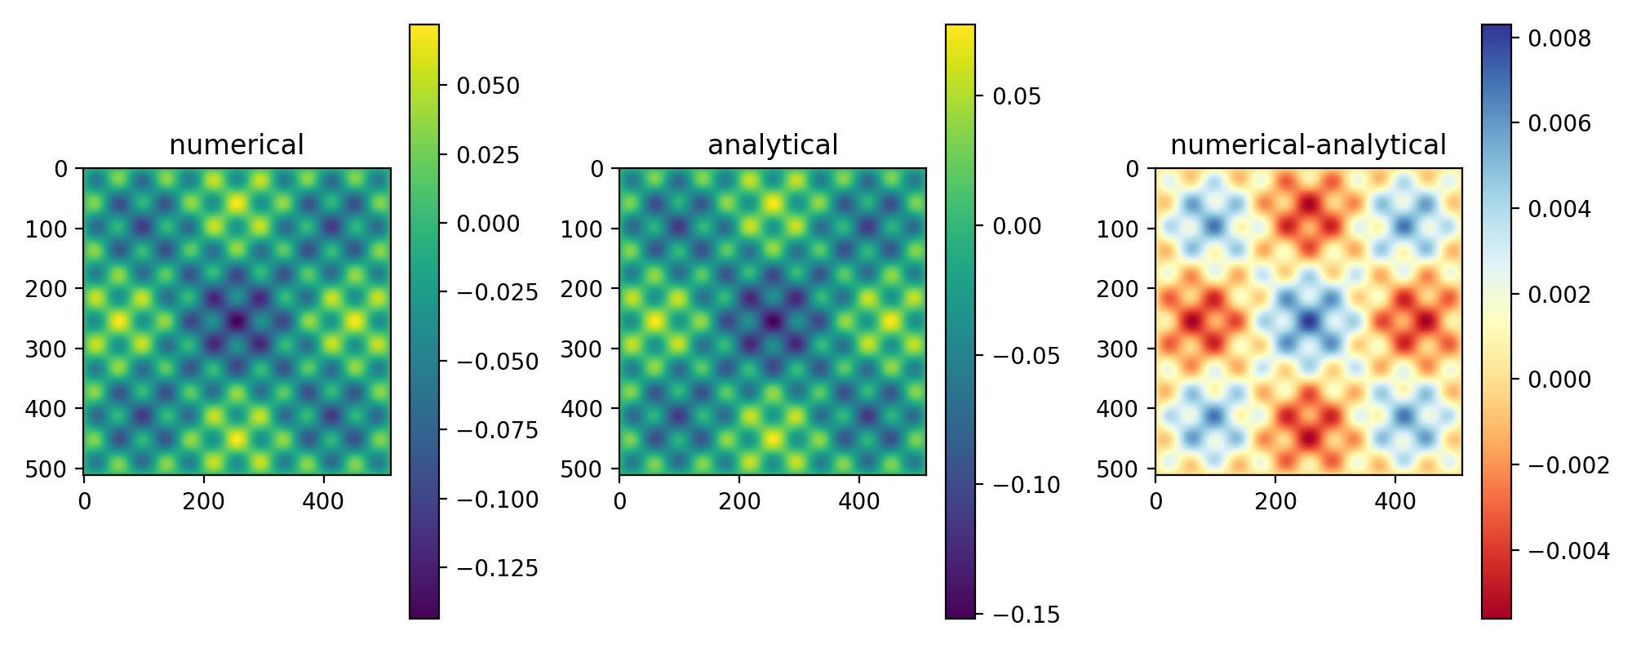
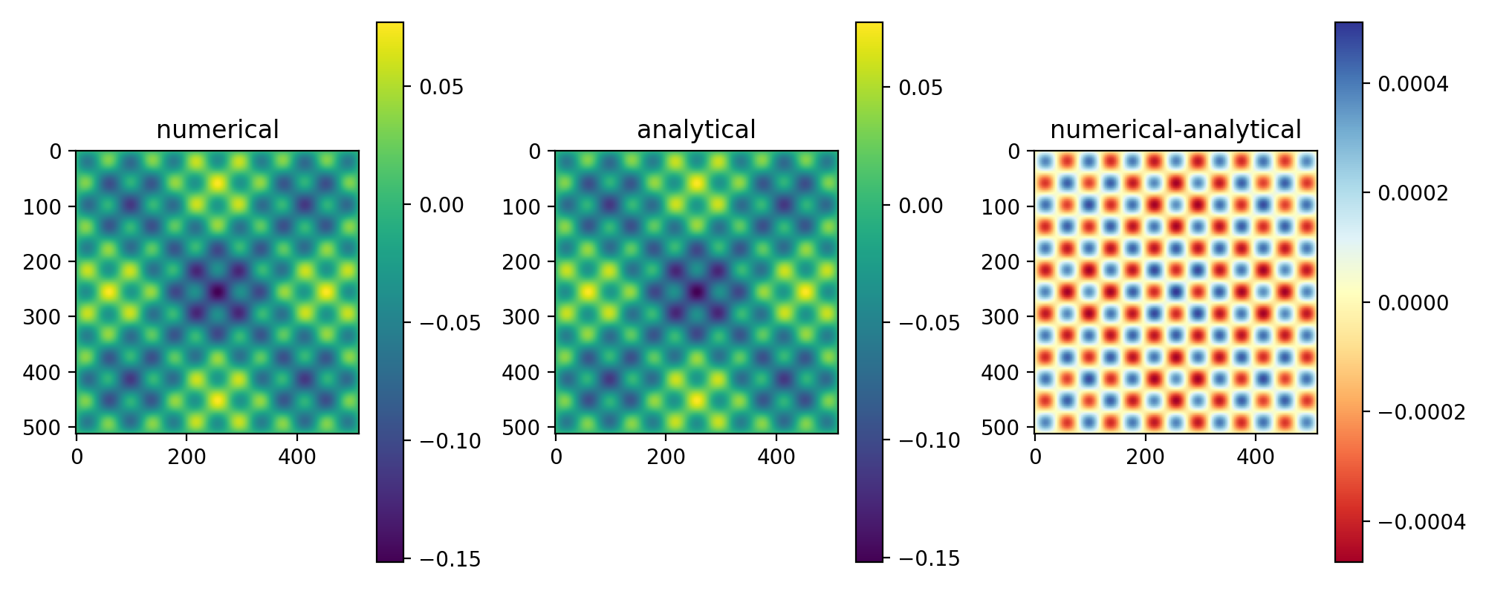
Full Multigrid(FMG) -Test Problem2
FMG
Error= 1.71e-04
F
Error=2.11e-03
Notes:
Source term 是 residual 還是 真正的source 的差別

Slide 19
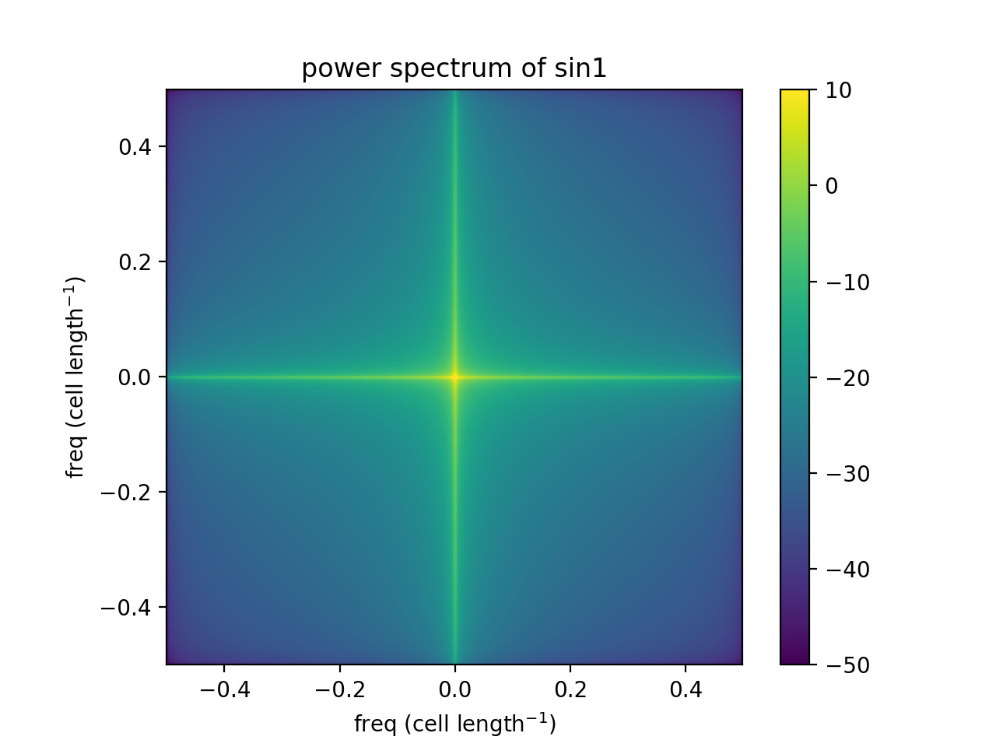
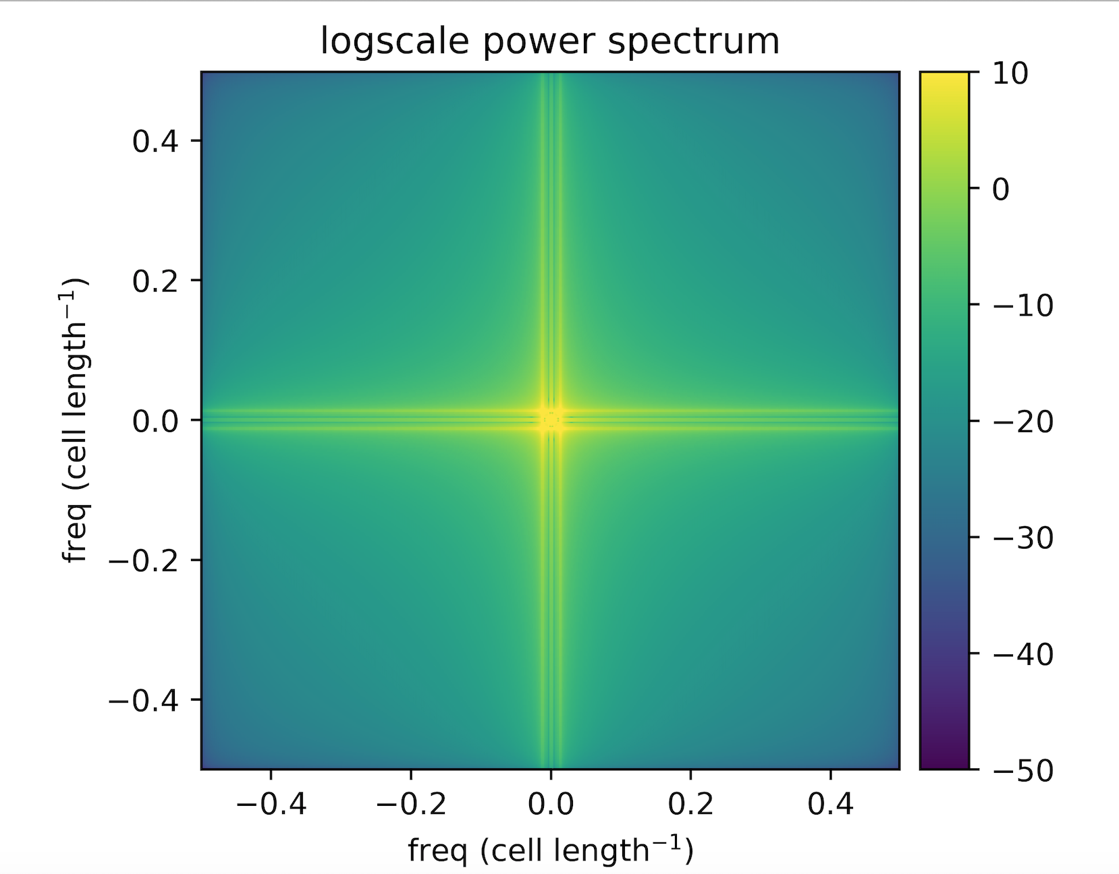
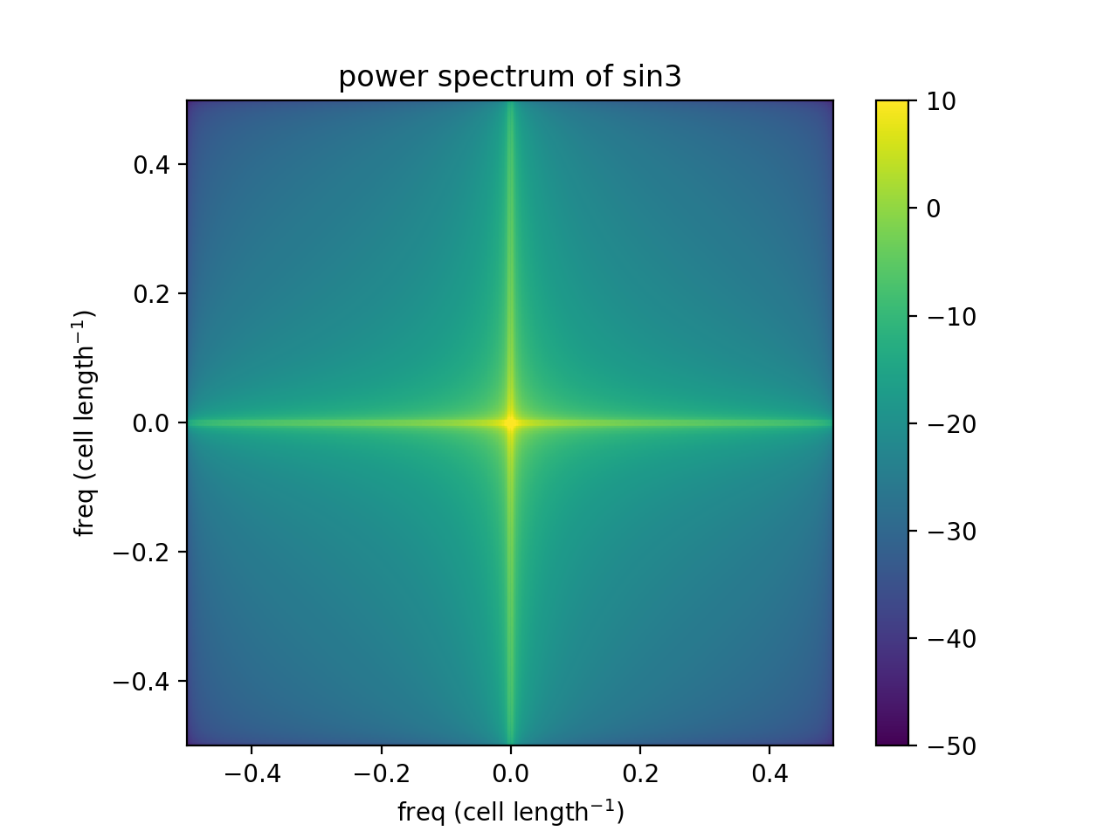
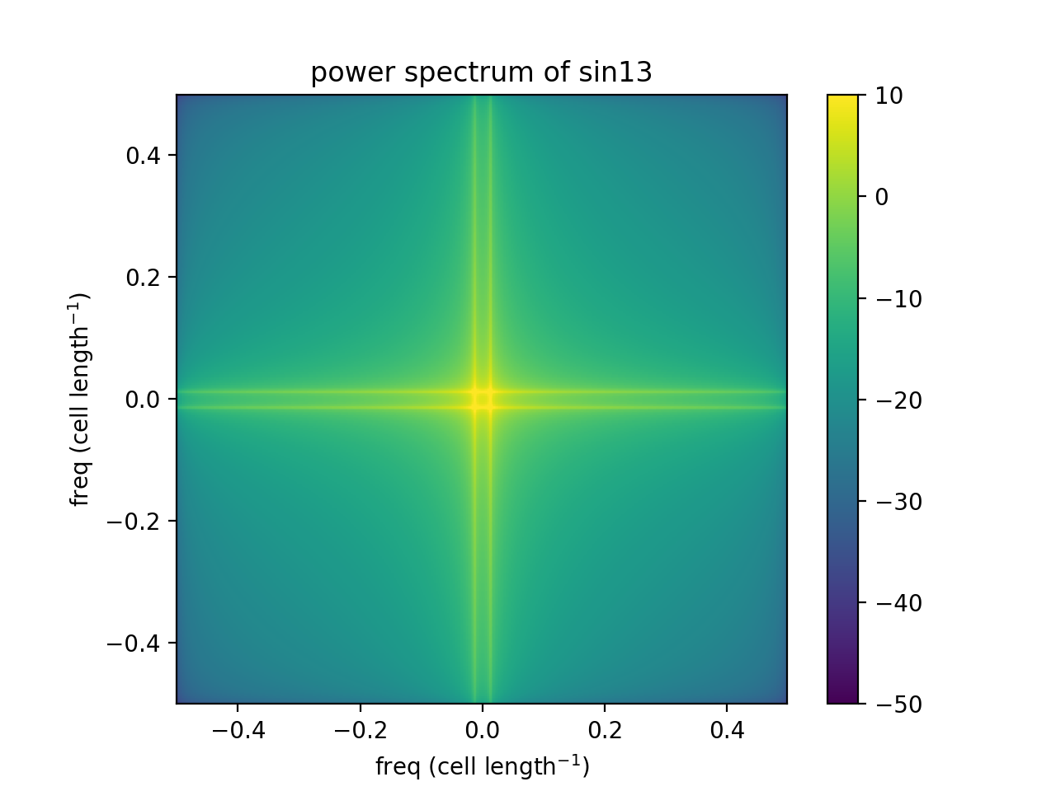
Power spectrum
$$u\left(x,y\right)=−0.5/π^{2}∙(sin\left(πx\right)sin⁡(πy)\text{+}\sin\left(3πx\right)sin⁡(3πy)\text{+}\sin\left(13πx\right)sin⁡(13πy))$$

Slide 20
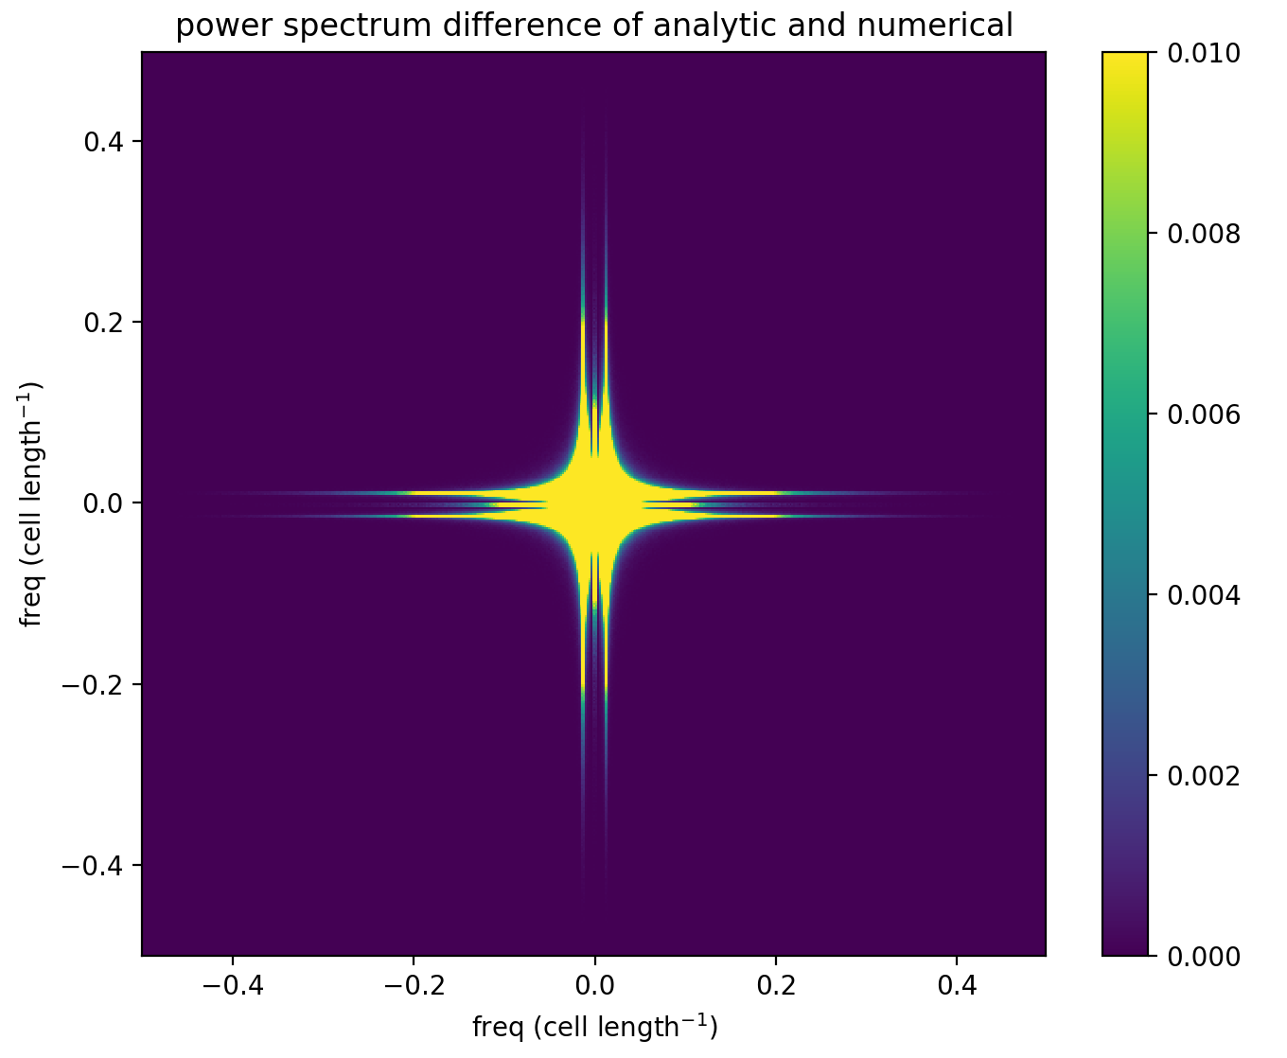
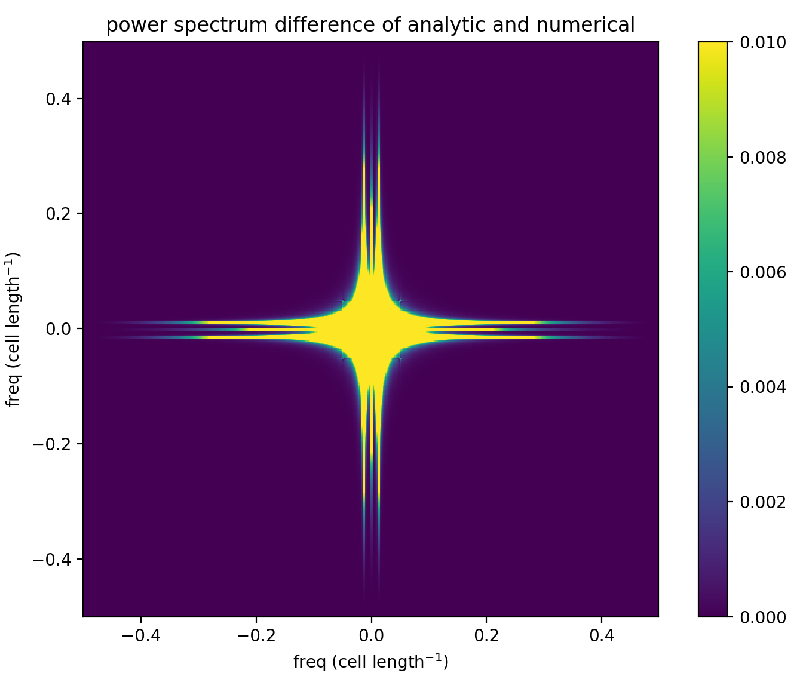
Power spectrum
FMG, Error= 1.71e-04
MG Fcycle, Error=2.11e-03

Slide 21
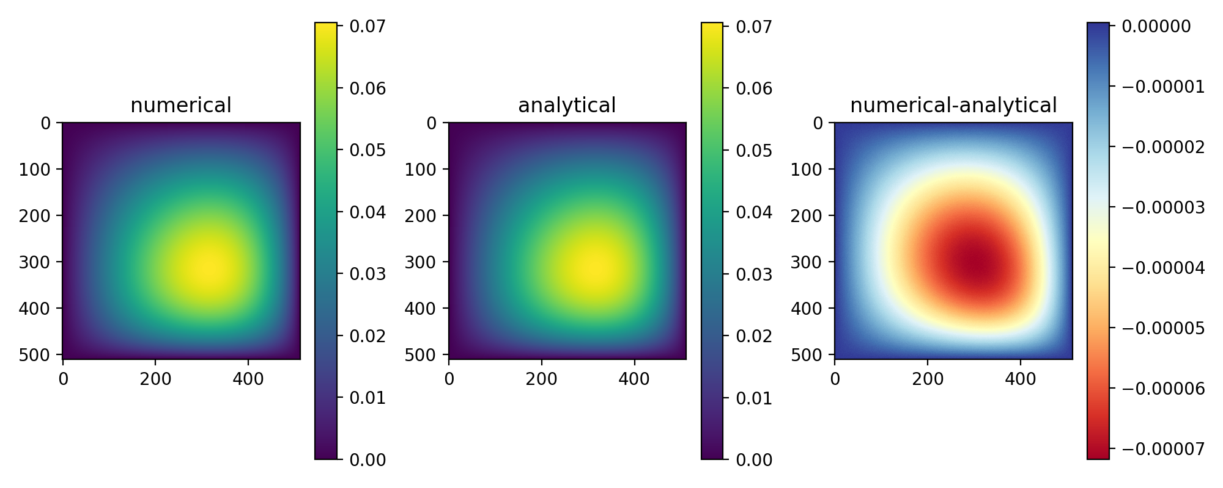
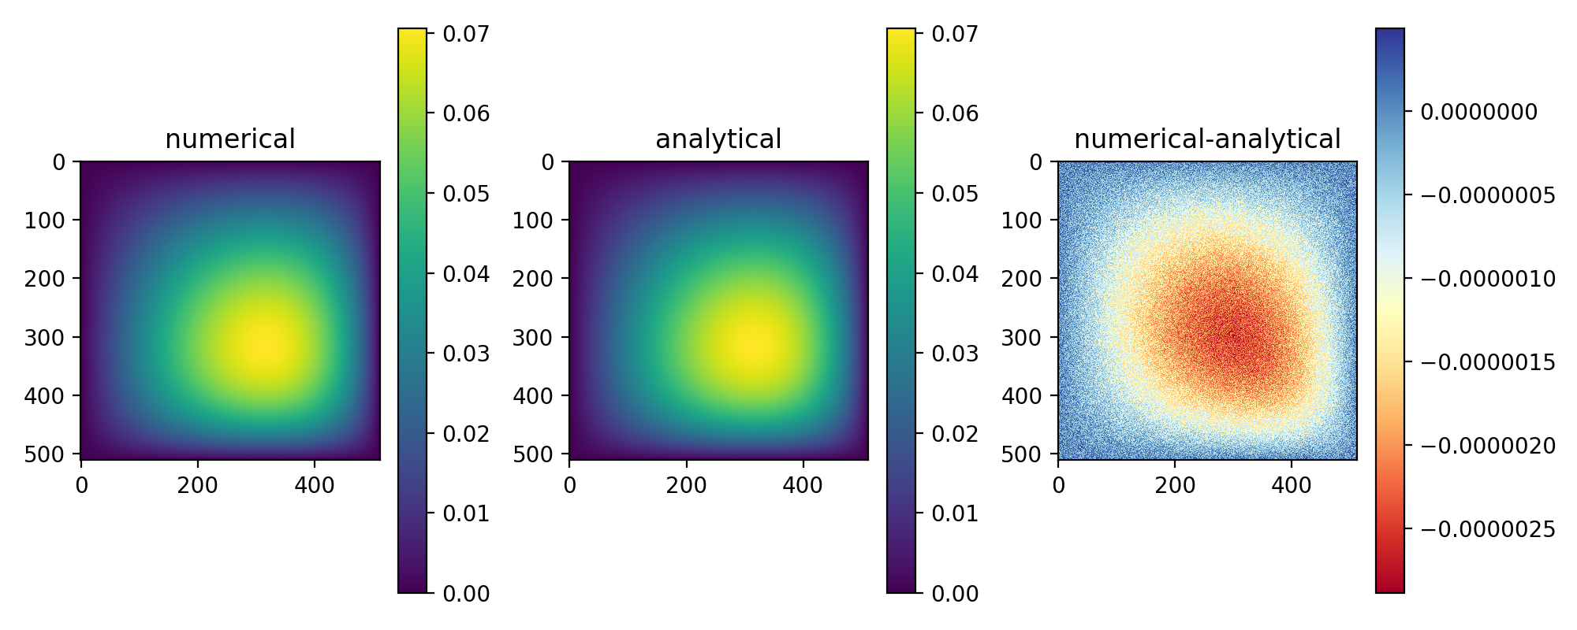
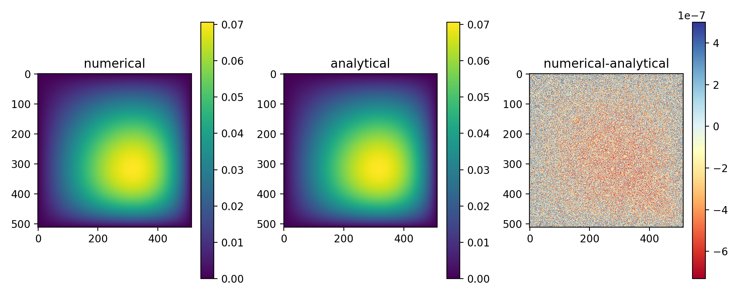

Repeat V cycle Test Problem1

Slide 22






Repeat V cycle Test Problem2

Slide 23
Repeat F cycle Test Problem2

Slide 24
Reference
Lecture 4 ppt
Numerical Recipe chapter 20.6
Multigrid Methods (Volker John)
Our Code
https://github.com/cindytsai/multigrid_poisson_solver

